Slide 1
Smart Wi-Fi Water Valve
TLL331501

Slide 2
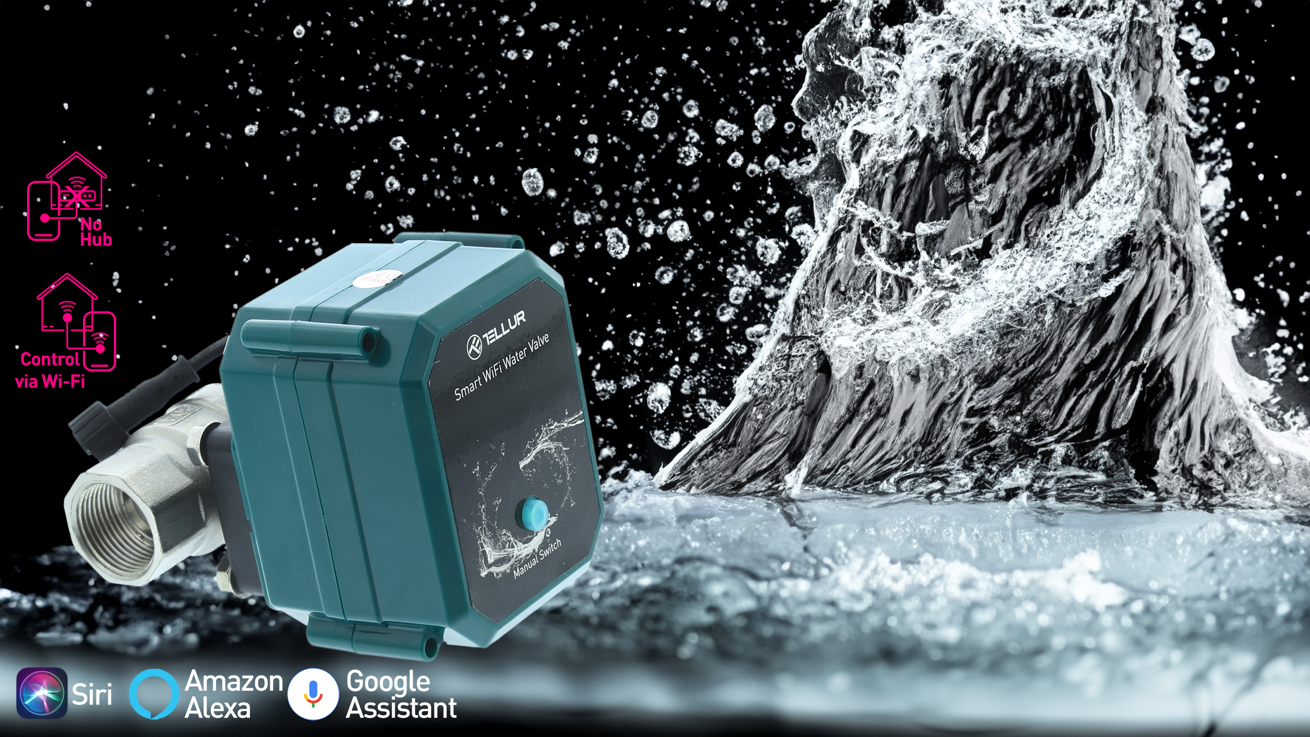
Tellur Smart Wi-Fi water valve, DN20, IP67, 10 bar, DC 5V

Slide 3
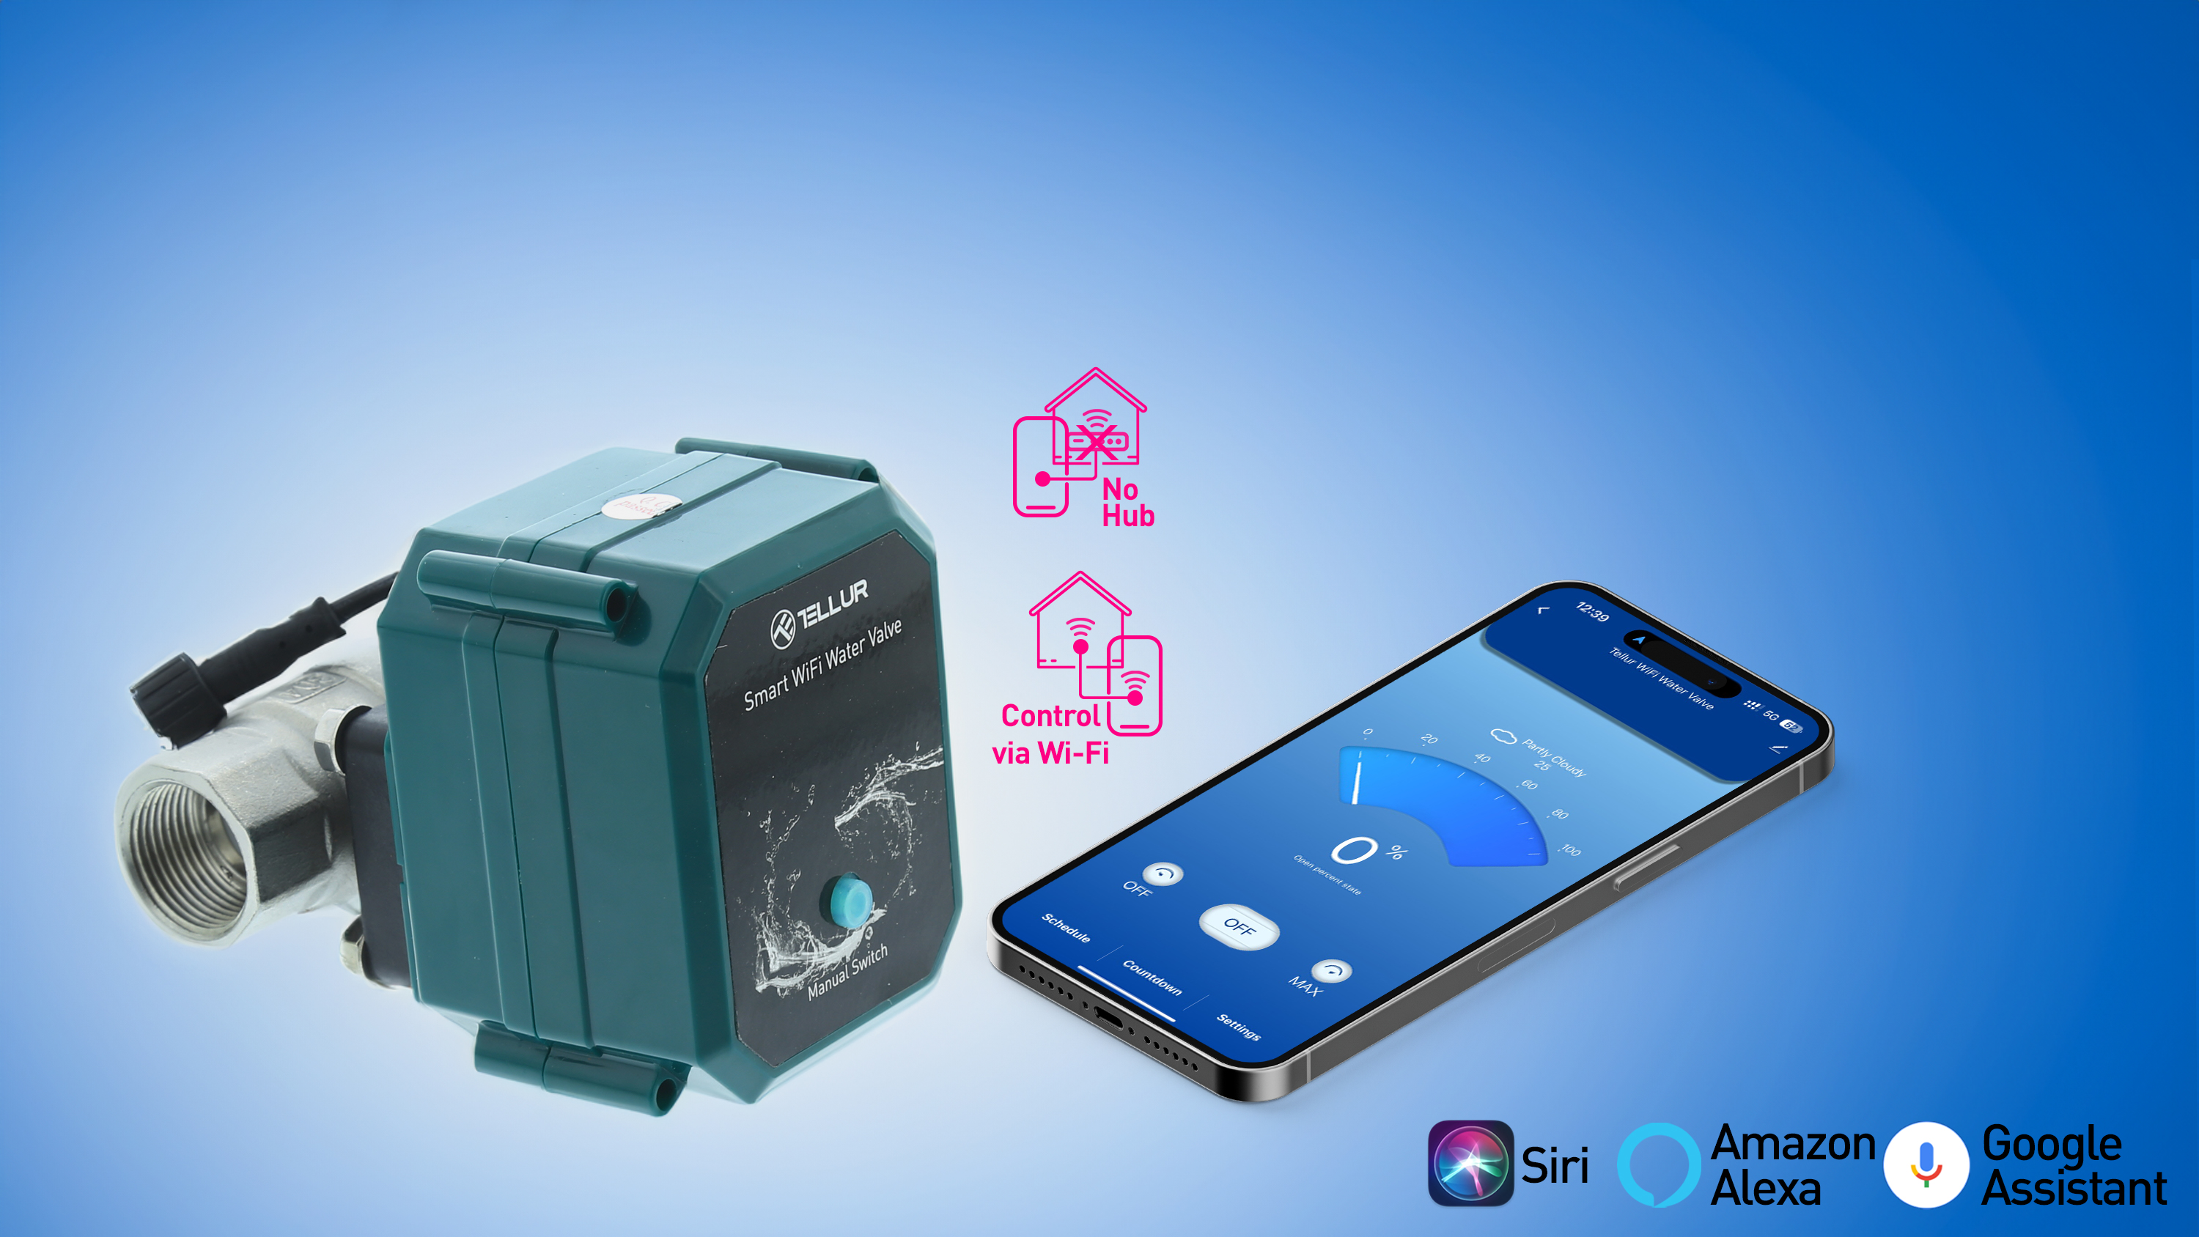
Smart Water Control
Programmable
IP67
Smart Water Valve

Slide 4
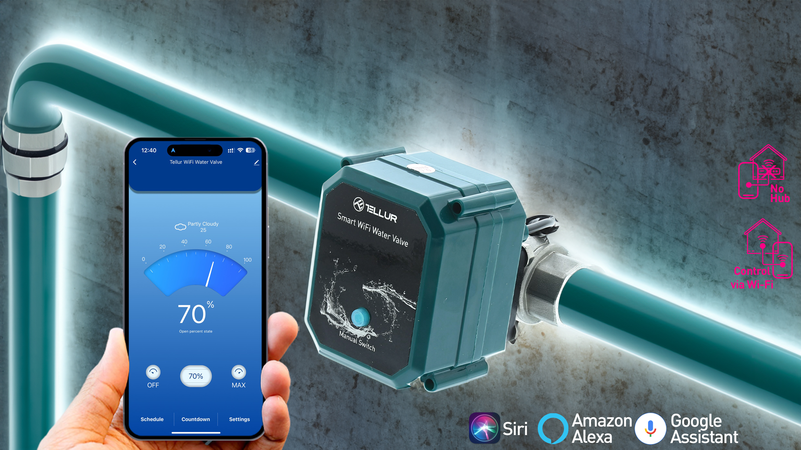
Integrated functions, fully customizable, smart scenarios
Protection against power failures
Easy to install and use with Tellur Smart App.
Perfectly integrated into the Tellur Smart ecosystem

Slide 5
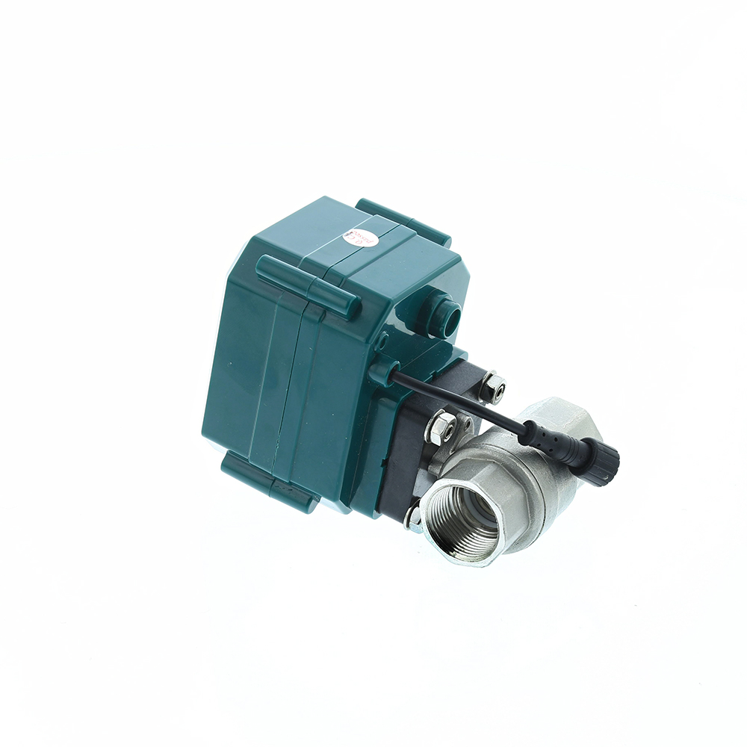
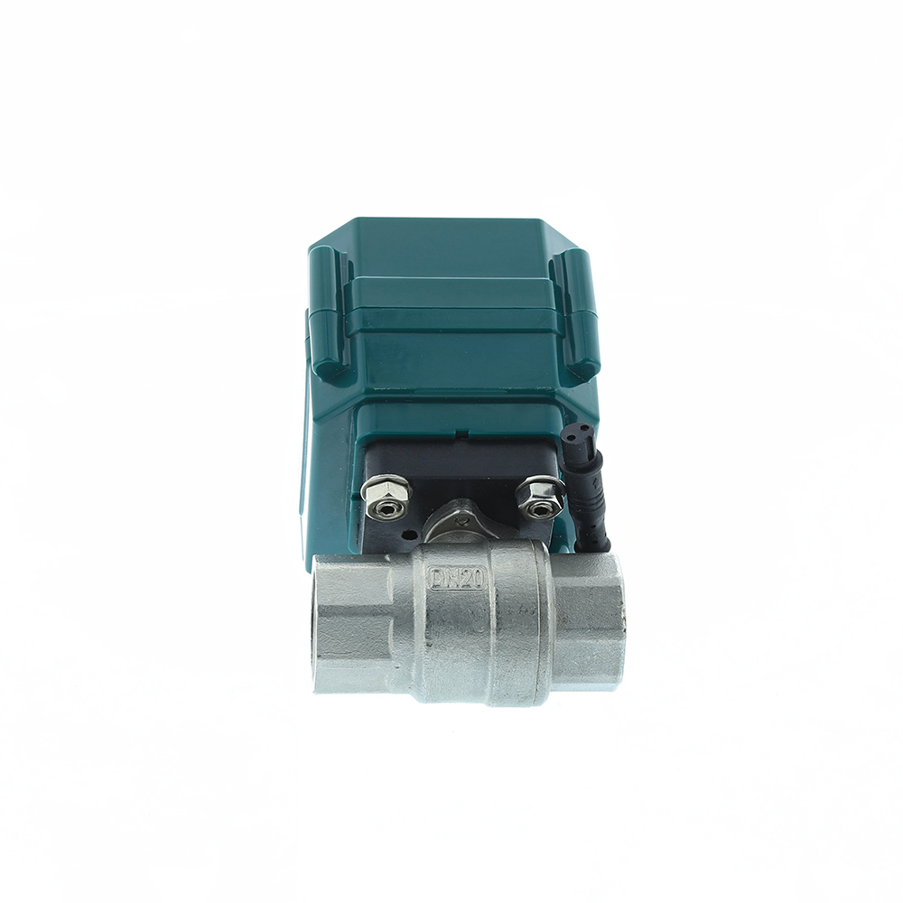
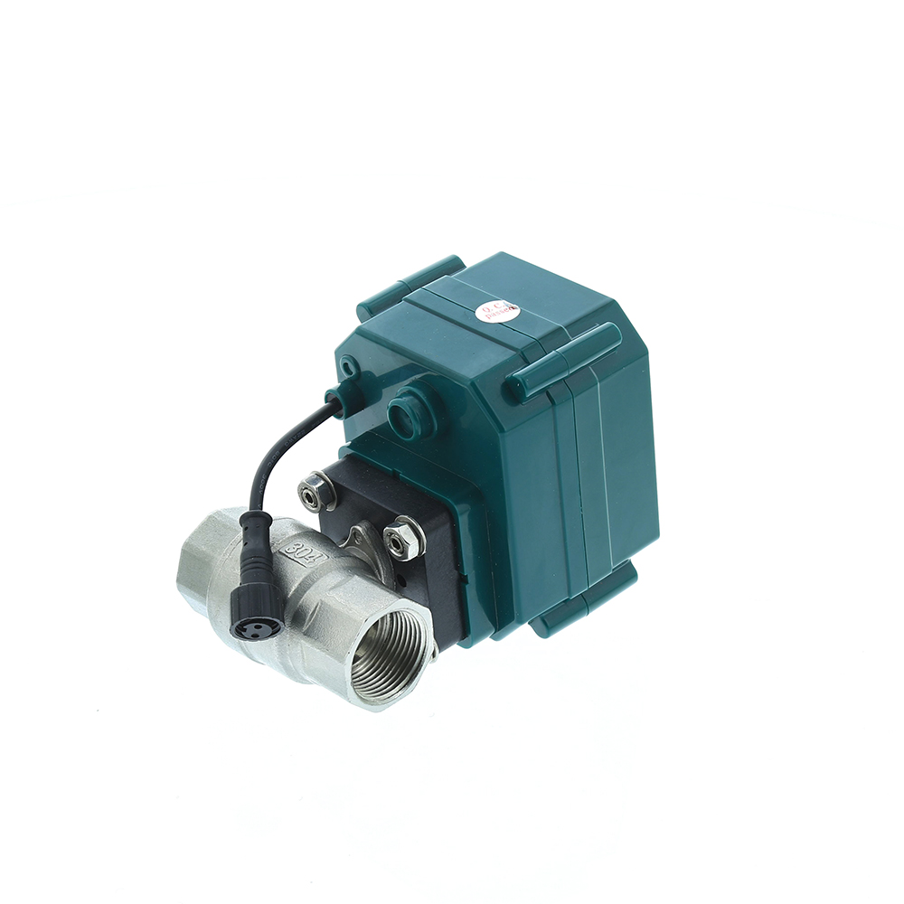
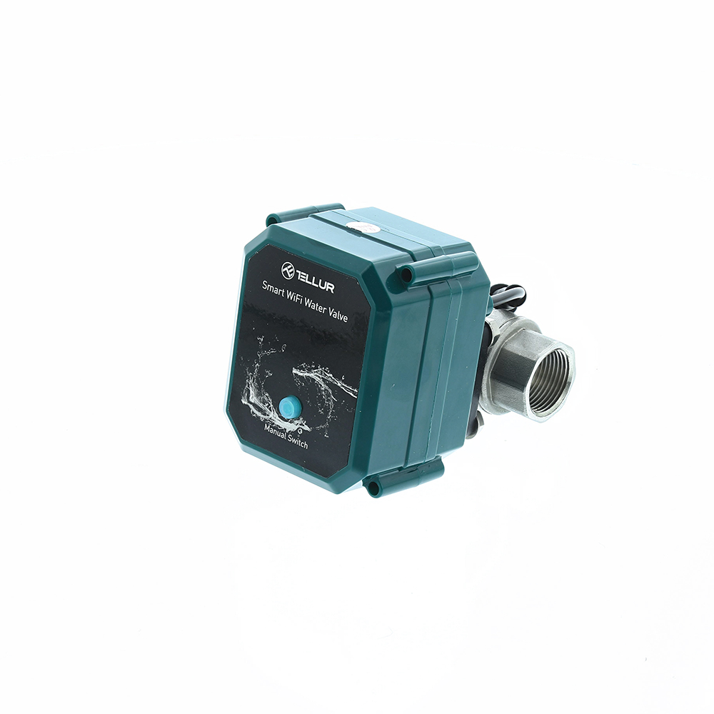
Technical specs
Input power: | USB DC 5V/2A (AC adapter not included)
Cable length: | 1.5 meter USB to 2pin waterproof socket connector
Pipe connector material: | SS304 (Stainless Steel 304)
Valve size: | DN20 (3/4") BSP thread
Max pressure: | 1.0 Mpa (10 Bar)
Waterproof rating: | IP67
Manual operation: | Fully open / fully closed by manual switch
Features: | APP Remote operation, Flow size control, Schedule and Countdown, Fully integrated in Tellur Smart ecosystem
Power failure protection: | Automatically close if unexpected power cutt off
Wireless frequency: | 2.4GHz
WiFi standard: | IEEE 802.11b/g/n (WiFi-6 not supported)
Security: | WEP, WPA/WPA2, WPA/WPA2 PSK (AES), WPA3
Encryption type: | WEP/TKIP/AES
APP Name: | Tellur Smart
APP Compatibility: | Devices with Android 4.2 / iOS 8 or more recently
Google Home: | Compatible
Amazon Alexa: | Compatible
Siri Shortcuts: | Compatible
Suitable for: | Indoor use
Working condition temperature: | -30°C ~ 60°C
Package include: | Smart WiFi Water Valve USB Power cable
Product dimensions: | 71 x 88 x 131mm
Product weight: | 730g
Package dimensions: | 210 x 160 x 90mm
Package weight: | 1000g
Product code: | TLL331501
EAN: | 5949120004633

Slide 6
THANK YOU!
For more products, please visit : https://smart.tellur.com

